Slide 1
The Hospice UK perspective 11 October 2016 Antonia Bunnin Director of Hospice Support and Development
Outcome measures in palliative care – a new future

Slide 2
“Let a hundred flowers bloom,
let a hundred schools of thought contend”

Slide 3
The game-changers
October 2013
December 2013

Slide 4
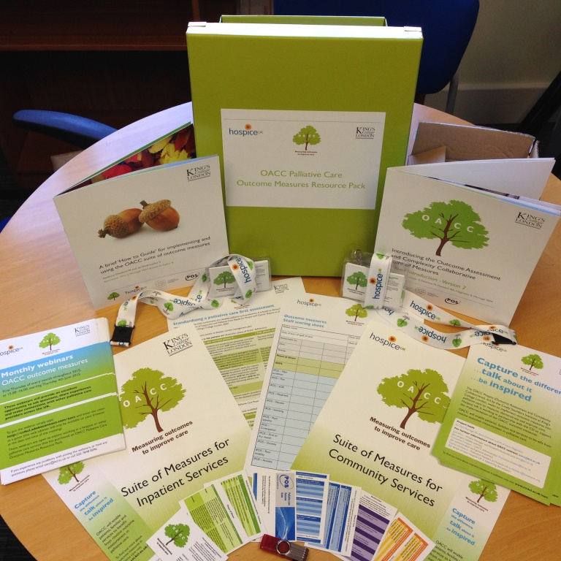
A lot has happened since then...
Monthly OACC webinars in 2015 & 2016
Jointly launched OACC Palliative Care Outcome Measures Resource Pack: May 2015
Jointly delivered OACC Train the Trainer workshops x7: March – Nov 2016

Slide 5
Where we are now
From “Let a hundred flowers bloom” … to carefully cultivating a small number of select plants!

Slide 6
Looking to the future
How can we cultivate and nurture?
What are the risks and threats?

Slide 7
Three key issues
Ensuring the full and strategic potential of OACC is understood internally
Ensuring the full and strategic potential of OACC is understood externally
Developing the support and resources to realise that potential

Slide 8
Ensuring full and strategic potential of OACC is understood internally
One of the biggest risks...

Slide 9
Ensuring full and strategic potential of OACC is understood externally

Slide 10
CCG statement on Quality Account
“We were pleased to note the hospice’s stated commitment to achieving the best possible outcomes for all its patients and those close to them. However, we were disappointed that no further information was given about how the hospice measures outcomes for patients, what outcome measurement tools they use and whether these are validated tools, and what steps the hospice has taken to understand and improve patient outcomes.
“In the coming year, we look forward to discussing with the hospice how the introduction of validated outcome measurement tools might be used to inform care to support individual patient needs, and indeed service design and commissioning.”

Slide 11
CCG statement on Quality Account
“We were pleased to note the hospice’s stated commitment to achieving the best possible outcomes for all its patients and those close to them. However, we were disappointed that no further information was given about how the hospice measures outcomes for patients, what outcome measurement tools they use and whether these are validated tools, and what steps the hospice has taken to understand and improve patient outcomes.
“In the coming year, we look forward to discussing with the hospice how the introduction of validated outcome measurement tools might be used to inform care to support individual patient needs, and indeed service design and commissioning.”

Slide 12
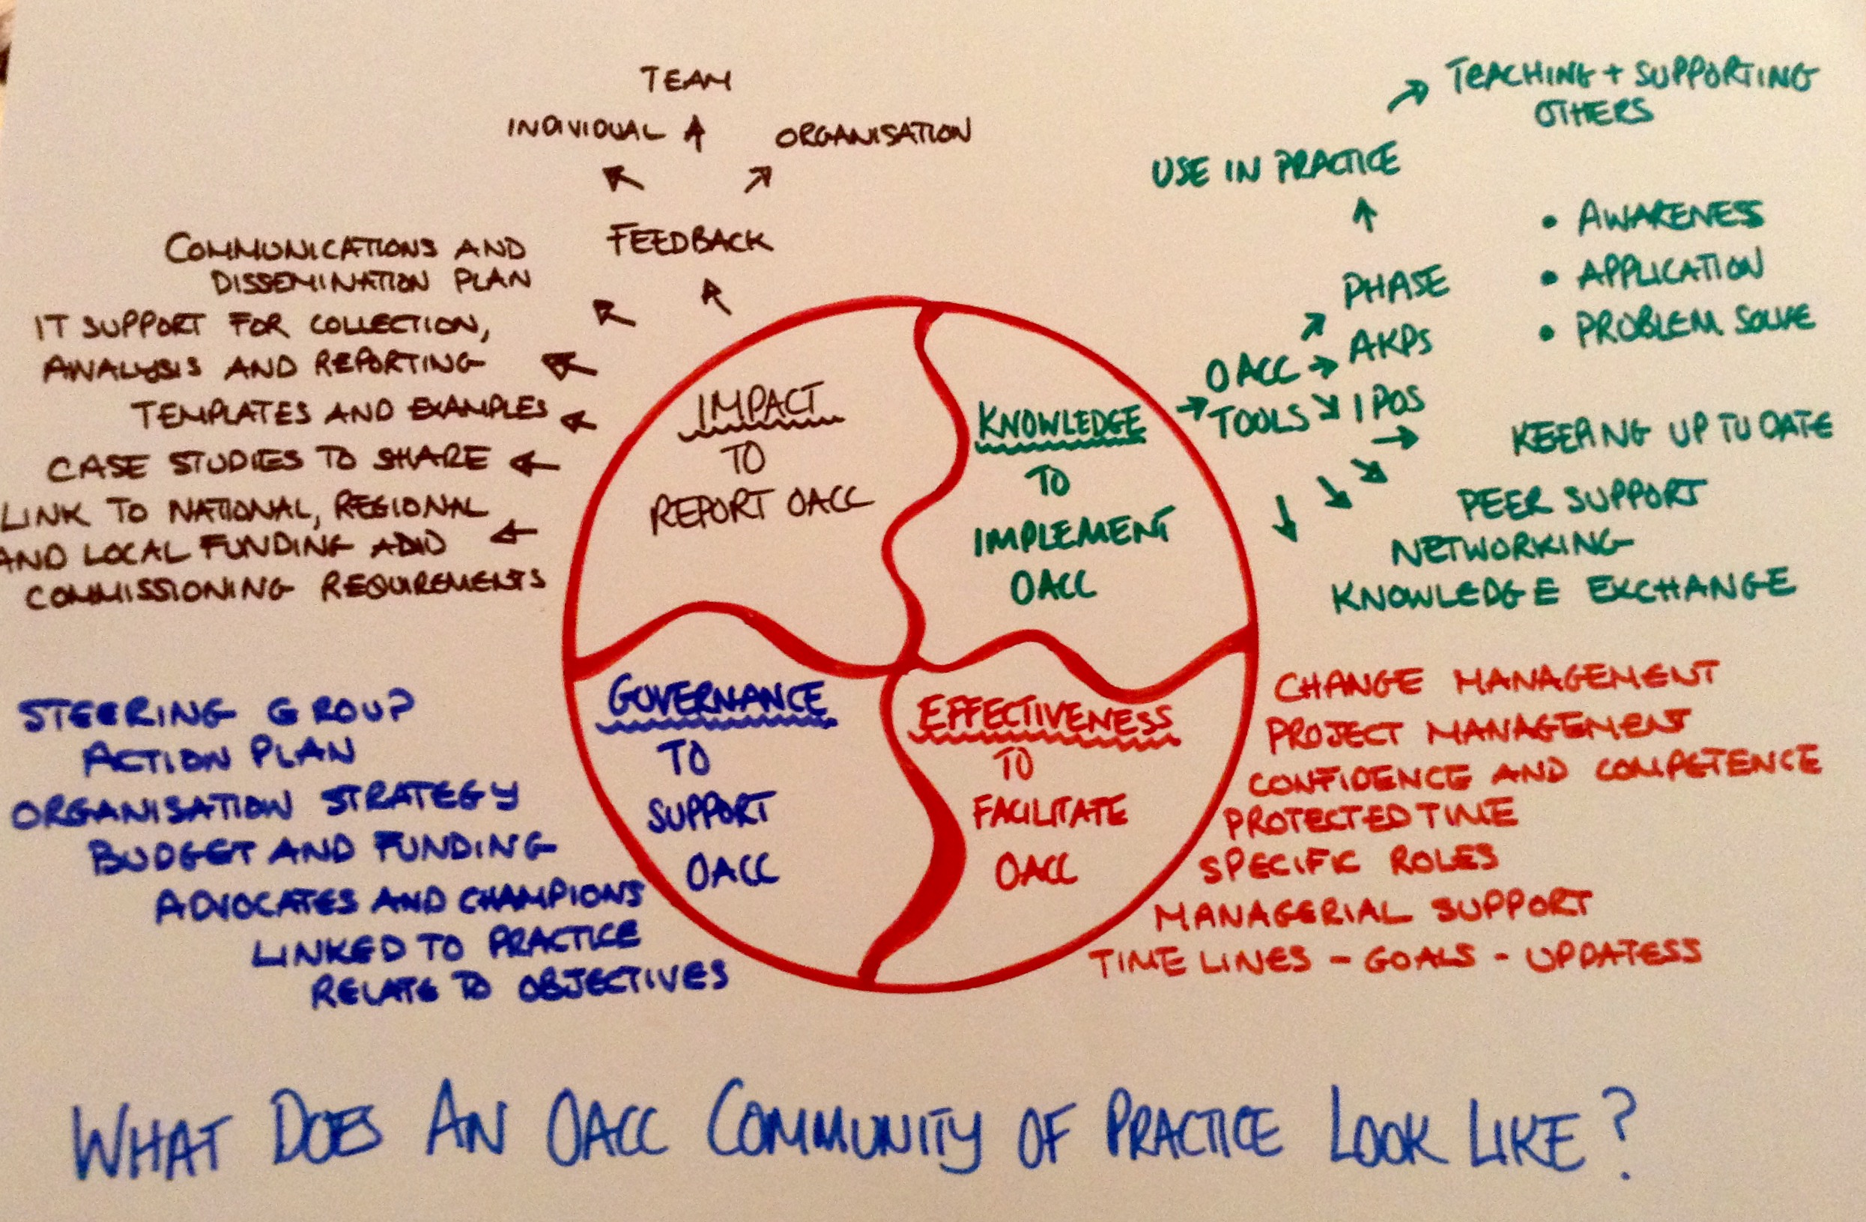
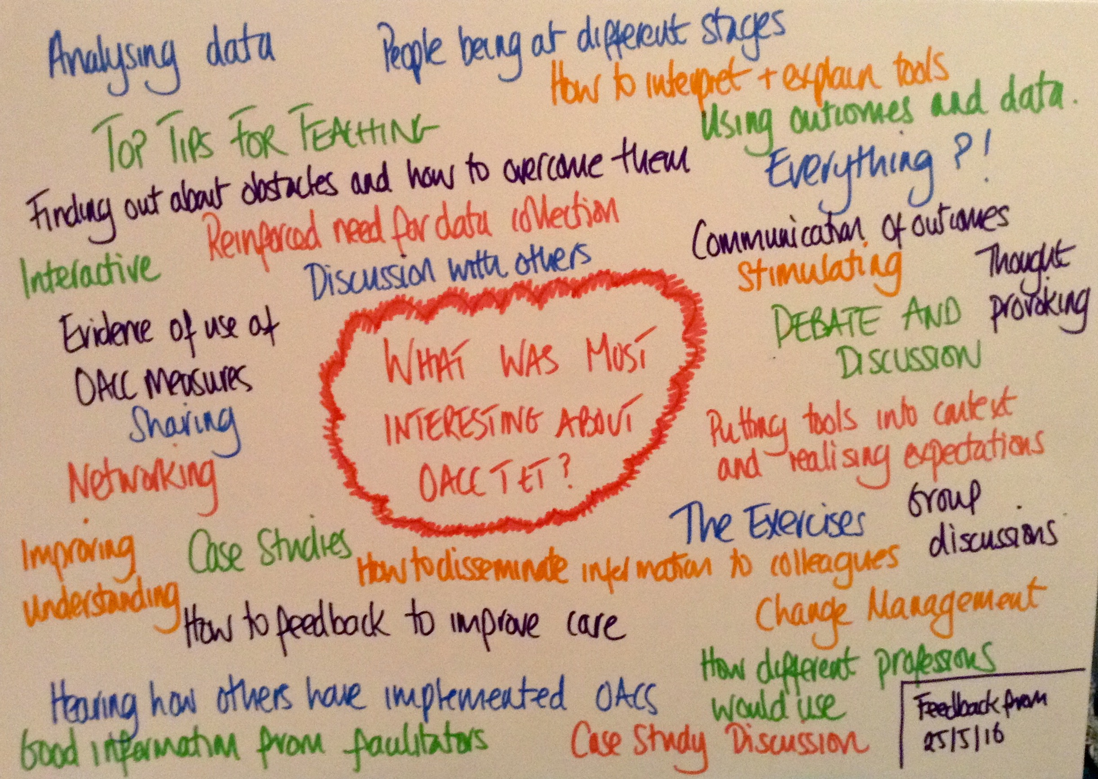
Developing the support and resources to realise the full potential of OACC
Feedback and ideas from the OACC Train the Trainer workshops...

Slide 13
“Mighty oaks from little acorns grow”

Slide 14
Thank you Antonia Bunnin Director of Hospice Support and Development a.bunnin@hospiceuk.org 020 7520 8201

