Slide 1
Using your data for service review, business intelligence and commissioning
Heather Richardson

Slide 2
First things first…
Thanks to CSI for opportunity to be part of OACC
Thanks to Fliss Murtagh for wisdom in understanding its meaning
Thanks to Joanna Davies for work on our data and some of the slides in this pack today

Slide 3
Overview of presentation
Thinking about our marketing mix
Service review
Business intelligence
Long term sustainability
Working with commissioners

Slide 4
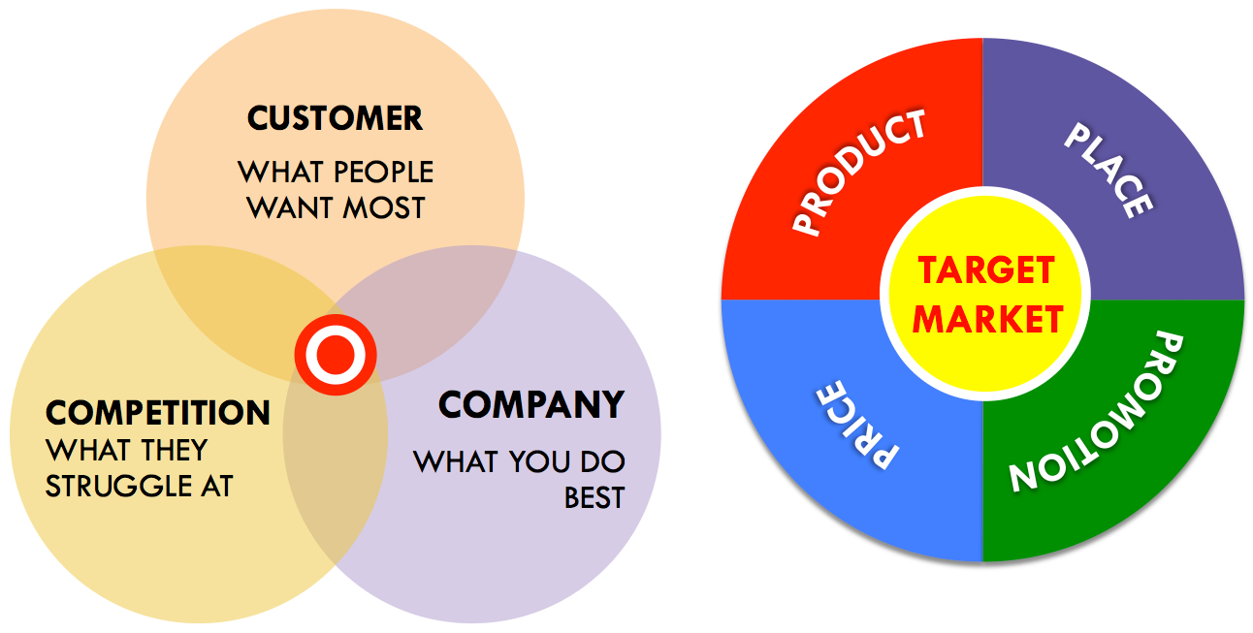
Marketing Mix

Slide 5
Some important questions to consider
What is it we really do and what specifically do we contribute to our local health economy?
How do we convey its value to commissioners and others?
Where do we best allocate our resources to achieve best outcomes at smallest cost?
Are our services worth their costs – to us and others?

Slide 6
What is it we really do and what specifically do we contribute to our local health economy?

Slide 7
Thinking critically about our offerings
How much of our care is really specialist in nature?
How do we describe that component beyond structure and process?
How do we translate the notion of “complex problems” into something more tangible that could guide referral decisions and consideration regarding the unique role we play in our local health economy
What aspects of our service are we selling to our commissioners and how do we differentiate between the specialist and other components in our discussions?
In the long term, do we want to separate them and what other markets would we want to work in?

Slide 8
An overview of our offerings at St Christopher’s
High
Research and evaluation
Complexity of need
Education and training
Care and support
Low
High
Reach

Slide 9
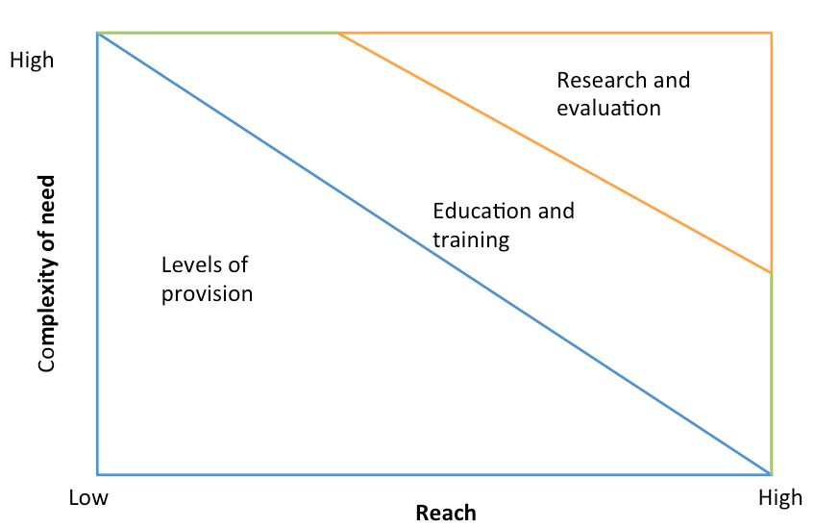
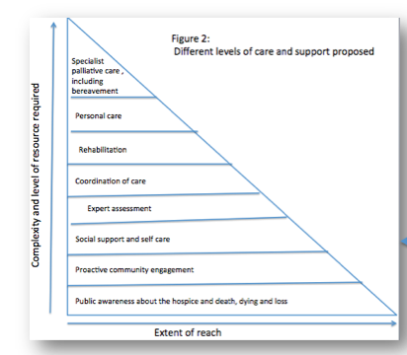

Slide 10
Are our services worth their costs – to us and others?

Slide 11
We are expensive and our reach at population level is limited
Costs are in the region of £19m a year
We rely heavily on voluntary giving to meet these costs (30% met from statutory services)
We spend just under £4m used to generate voluntary funding
Our community make a huge contribution – over £30,000 a day!

Slide 12
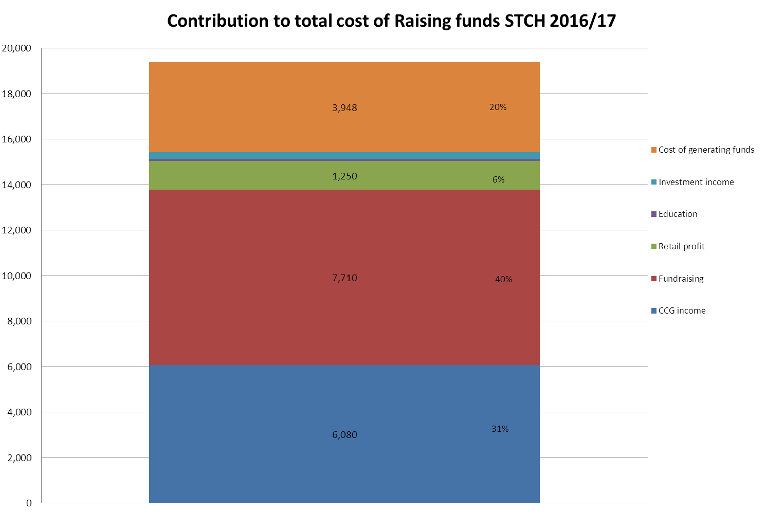
Contributions to St Christopher’s Costs

Slide 13
Thinking about our beneficiaries and extent of reach (2015/16)
We are pleased to note increasing nos of people receiving our care:
3,426 – Patients to whom we provided care
1,233 – Adults who received bereavement support
562 – Carers who received support from the hospice
475 – Children and families cared for by Candle Bereavement Service
336 – Personal care clients
But: when we look at the total no of deaths in the area (9600), we are only reaching a relatively small proportion

Slide 14
We are expensive when we look at the cost per patient
Around £360 a day for a bed (without overhead costs)
Around £150 a week for community palliative care
Around £100 per attendance in our Anniversary Centre
How do we justify them?

Slide 15
How do we convey the value of what we do to commissioners and others?

Slide 16
We want to change our relationship with our commissioners
Our contract comprises historic currencies, some even outside our control
We are reporting on all our services despite only receiving funding to the value of 30% of our costs
We don’t consider our performance in relation to population needs, only what we have achieved in past years
The quality improvements they require are often at odds with the gaps we identify in our provision
We are concerned about implementing better ways of using our resources if it could mean we fail to meet our contractual requirements

Slide 17
The new world to which we aspire..
A co-commissioning relationship
Focused on the needs of our shared population
Driving towards better outcomes for our beneficiaries
Reflected in the currencies of our contract and any CQUINs

Slide 18
Where do we best allocate our resources to achieve best outcomes at smallest cost?

Slide 19
Thinking about our cost effectiveness
We provide a broad range of services with a variety of inputs in terms of staff, skills and other resources
  How similar or different are the needs of people using the different services?
  Are similar services producing the same outcomes?
  When patients are transferred between services, or new services made available, does this improve their outcomes?

Slide 20

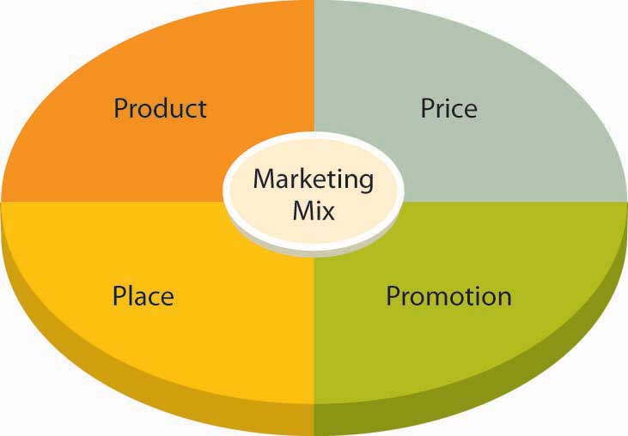

So how can outcome measures help us with these dilemmas?
Assisting with

Slide 21
Two sets of OACC data
Data collected between Jan and May 2015
  Around 850 patients
Data collected between Jan and July 2016
  2,465 patients
  3,023 spells of care
  4,915 Phases of illness

Slide 22
What are we measuring?
Phase of Illness – more about this in the following slides
AKPS: measure of functional status; 0-deceased to 100 best possible function
IPOS: 17 items, common symptoms & problems in palliative population, 5 point scale, 0 absent to 4 overwhelming
Barthel: measure of function on main Activities of Daily Living
Views on Care (VoC): 4 questions about QoL and service
Zarit Carer interview: 6 questions for carers

Slide 23
Thinking about the product…
Thinking about the severity of their symptoms
Considering other problems that must be addressed

Slide 24
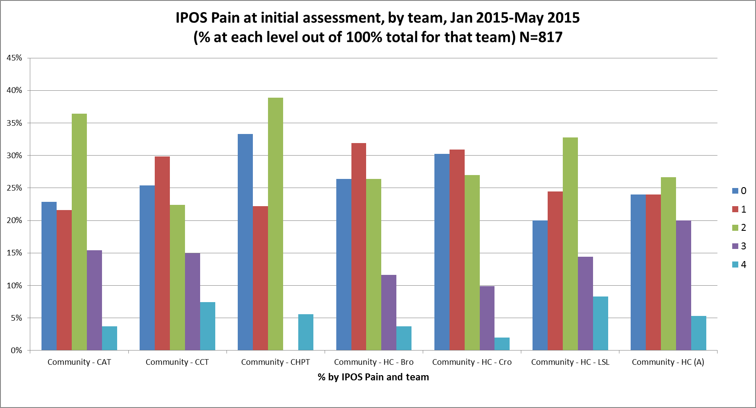
What about severity of symptoms? Looking here at IPOS Pain scores 3 (purple) & 4 (light blue):
All teams have patients with severe/overwhelming pain despite the variations in phase and functional status
Notes:
We are looking after people, many of who have sever/overwhelming pain

Slide 25
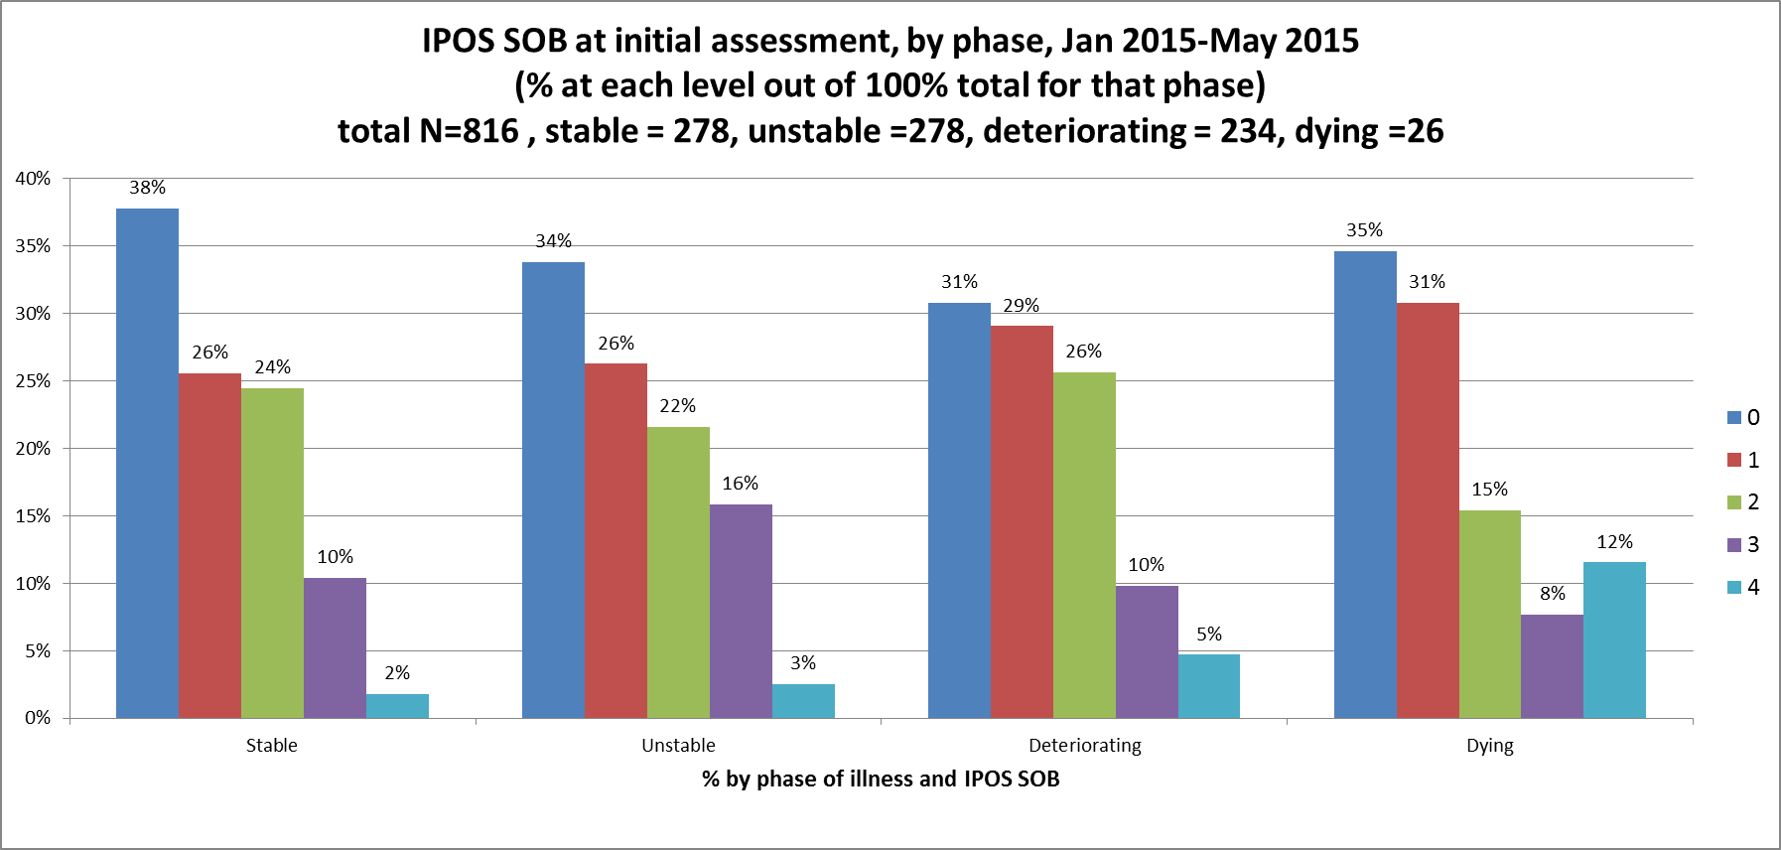
Community patients
Here are the IPOS SOB scores, grouped by Phase of Illness:
Severe or overwhelming breathlessness occurs across the Phases: in the unstable group 19%, deteriorating (15%), and dying (20%), even the stable group have 12% severe or overwhelming
Moderate/severe/overwhelming SOB problematic in the
Dying phase (35%) - although small numbers here

Slide 26
Phase of illness by Phase number within spell - inpatients
Notes:
Their condition is a changing picture. Up to 6 phases within a single spell of care
Even so we manage to move a significant proportion from an unstable phase to stable

Slide 27
Phase and AKPS
Notes:
Patients’ deteriorating condition is often accompanied by a decrease in functionality

Slide 28
Thinking about place of care….
Ensuring people are in the right service to meet their needs
Considering how their condition changes in the course of a spell of care and what implications this has for where they go next

Slide 29
Phase of Illness in St Christopher’s patients

Slide 30
Comparing Phase of Illness across teams

Slide 31
Comparing function (AKPS) across teams

Slide 32
Comparing symptom burden (IPOS) across teams

Slide 33
Thinking about the “price” of our service
Providing evidence that we are worth the cost

Slide 34
Patient outcomes:
Of those who had a moderate, severe or overwhelming symptom or problem at the start of Phase what % had improved by the end of Phase?

Slide 35
% of patients who had moderate/severe/overwhelming problems at the start of Phase and had improved by the end of Phase: Community

Slide 36
Still thinking about potential areas for benchmarking, but now focusing on anticipatory care
Outcomes:
Of those who had absent or mild problems at the start of Phase who had not worsened by the end of Phase?
Capturing the work of teams to prevent worsening of outcomes despite deteriorating health

Slide 37
% of patients who had absent or mild problems at the start of Phase who did not deteriorate by the end of Phase: Community

Slide 38
Thinking about promotion
Explaining to commissioners and others the difference that we can make – beyond and in addition to good patient experience
Considering the value of this contribution in the wider health economy

Slide 39
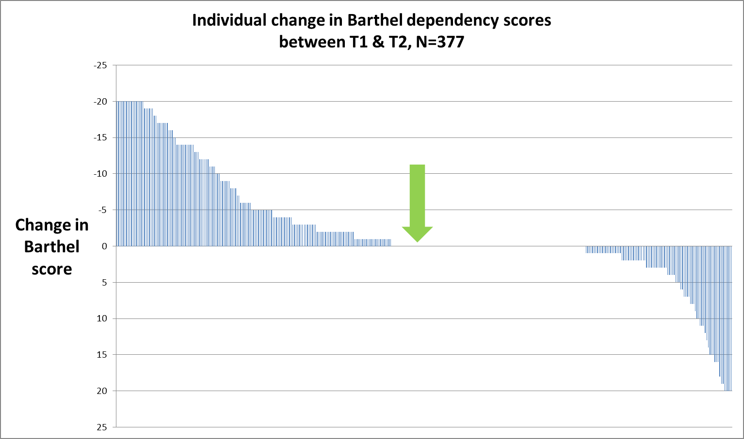
Change in dependency between T1 & T2 (N= 377)
Falling score = increasing dependency
Y-axis reversed so those on left are getting worse, those on right improving
More are getting worse than getting better, but quite a range and some extreme changes
Median change 0 Mean change -2.3(SD 7.89)
NB Earlier data

Slide 40
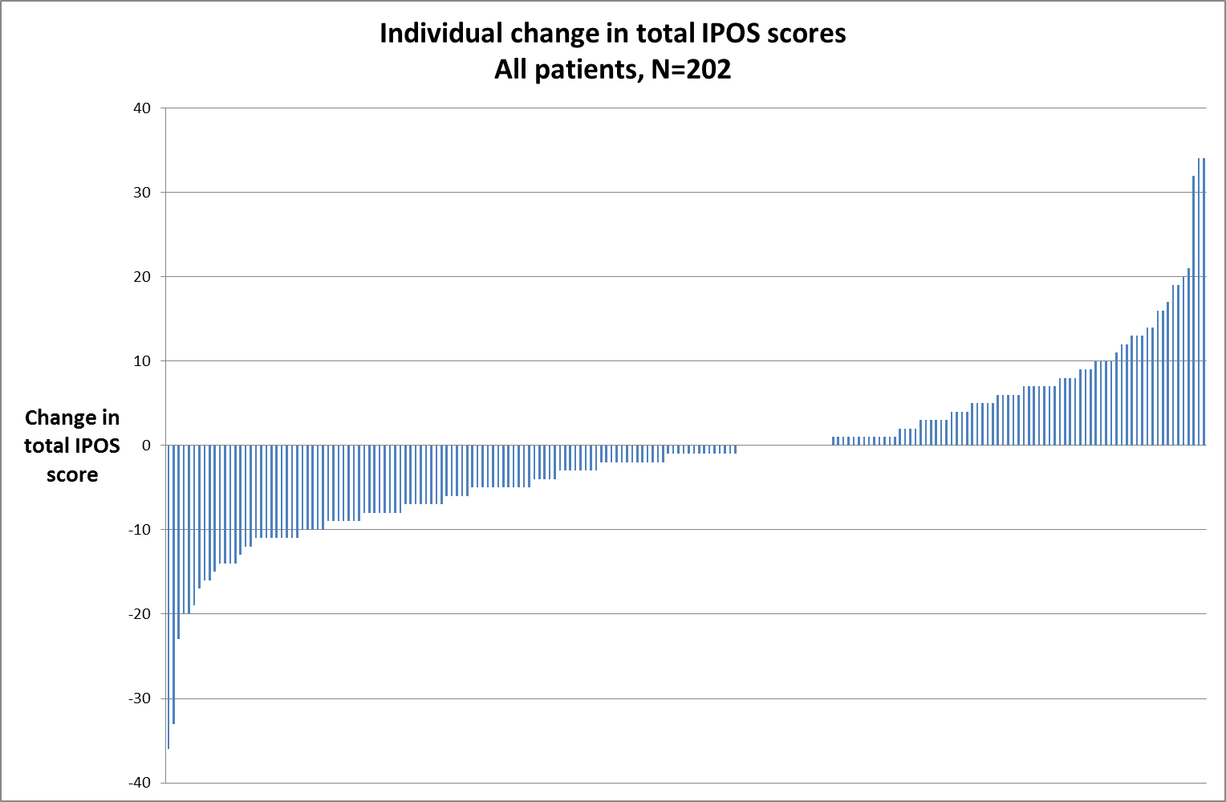
Community patients
Each individual bar represents a patient. Scores are negative (below the x-axis) if the total IPOS score reduces (less symptoms & concerns) between T1 & T2, above if it increases
Over 50% of all patients have an improvement in total IPOS score,
despite advancing illness
Median change score - 1 Mean change score – 1.12 (SD 9.61)
NB Earlier data

Slide 41
Final thoughts
We are just starting to see the potential of outcome data to inform business processes
We are beginning discussions with our commissioners drawing on these data
Our challenges lie in the completeness of our data across all services and engaging non clinical staff in its richness
It will invest significantly in it to ensure we are using it to maximum effect.

Slide 42
Thank you
H.Richardson@stchristophers.org.uk

