Slide 1


Interpretation and use of outcomes data in Australia
Fliss Murtagh
Cicely Saunders Institute
Department of Palliative Care, Policy & Rehabilitation
King’s College London
fliss.murtagh@kcl.ac.uk

Slide 2
Overview
What is PCOC?
What do they collect in PCOC and how does it compare to OACC?
How does PCOC support services?
Examples of findings
What about national quality indicators?
National workshops
Discussion on future directions

Slide 3

What is PCOC?
The Australian national Palliative Care Outcomes Collaborative (PCOC)
www.pcoc.org.au

Slide 4
A framework for demonstrating and improving quality of care
PCOC aims to embed nationally standardised clinical assessments and point-of-care data collection into daily practice
  Regarded as palliative care ‘vital signs’
In order to drive quality and outcome improvement
  With a feedback loop to individual services
  Identifying individual improvement opportunities
  Facilitate service to service benchmarking

Slide 5
A partnership between 4 universities for national palliative care benefit
University of Wollongong – Professor Kathy Eagar
Queensland University of Technology – Professor Patsy Yates
Flinders University – Professor David Currow
University of Western Australia – Associate Professor Claire Johnson
University of Wollongong leads PCOC

Slide 6
Development of PCOC
Voluntary collection of pt level outcome measures
Funding from Australia’s national Palliative Care Programme
Development work started in 1998
5 clinical assessment tools adopted in 2005 - reviewed 2013 – no major changes
Key quality indicators and outcome benchmarks developed progressively from 2009 onwards, through consultation with sector
Benchmarks are reviewed and modified based on the trends in outcome data
More than 110 services (88%) reporting nationally

Slide 7
All services in PCOC

Slide 8
Point-of-care data collection, routine reporting, feedback and benchmarking:
Point-of-care data collection
Routine reporting to PCOC
National benchmarking
Structured feedback to teams
Every
six
months

Slide 9
New approach to ‘unit of counting’
Patients have one or more episodes (‘spells’ in NHS) of palliative care (defined by setting)
Episodes of care consist of one or more Palliative Care Phases (stage of illness):
  Stable
  Unstable
  Deteriorating
  Terminal / Dying
  Bereaved
The ‘outcome’ is the change in the measure from the beginning to the end of each phase

Slide 10
Overview
What is PCOC?
What do they collect in PCOC and how does it compare to OACC?
How does PCOC support services?
Examples of findings
What about national quality indicators?
National workshops
Discussion on future directions

Slide 11
Five clinical assessment tools in PCOC:
Phase
Eagar et al, 2004
Functional status and dependency
RUG-ADL
Fries et al, 1994
AKPS
Abernethy et al, 2005
PCPSS
Eagar et al, 2004
Pain and other symptoms
SAS
Aoun et al, 2004

Slide 12
4 + 1 clinical assessment tools in OACC:
Phase
Eagar et al 2004, Masso et al 2015, paper in prep
Functional status and dependency
Barthel
Colin et al 1988, Wade et al 1988, etc
AKPS
Abernethy et al 2005, etc
IPOS
Higginson et al 1998, Murtagh et al 2006, etc
Pain and other symptoms
Views on Care
Addington-Hall et al, 2014
Further paper in prep
Carer measures

Slide 13
Reporting to each service
Phase, AKPS, RUG-ADL
PCPSS and SAS - all domains are included
From PCPSS:
  Pain
  Other symptoms - grouped
  Psychological
  Family
From all domains of SAS:
  Range of additional symptoms (SOB, constipation, nausea, insomnia, appetite, etc)

Slide 14
Overview
What is PCOC?
What do they collect in PCOC and how does it compare to OACC?
How does PCOC support services?
Examples of findings
What about national quality indicators?
National workshops
Discussion on future directions

Slide 15
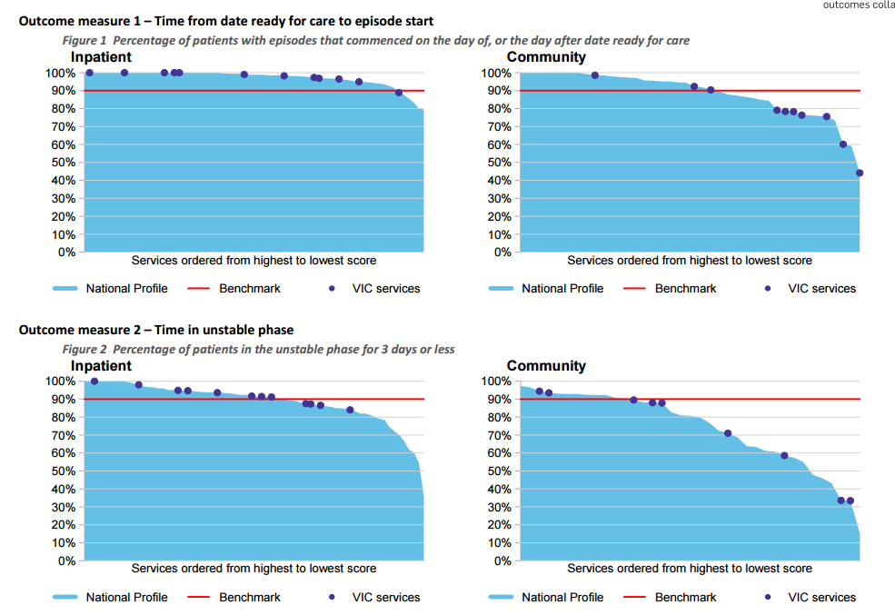
How PCOC supports services - 1
PCOC six monthly reports
A unique report for each service and each region

Slide 16
How PCOC supports services - 2
PCOC Quality Improvement Facilitators (QIFs)
  Each QIF is the first point of contact for all of the services in a region. Role includes:
  Education in the clinical assessment tools and protocols
  Assistance with process re-engineering
    Embedding PCOC assessments into routine practice
  Structured feedback after each report
  Facilitating access to the evidence on how to improve
  Supporting and promoting PCOC champions
  Networking ‘like’ services and encouraging them to share learning with each other

Slide 17
How PCOC supports services - 3
PCOC holds national benchmarking workshops
  Minimum of four a year
  ‘Peer’ services together from across Australia
    Large inpatient units / hospices
    Small inpatient units / hospices
    Large community palliative care services
    Small community palliative care services (mostly rural)
    Consultation liaison services
  Professional rules of engagement
  Purpose is to network and learn from each other

Slide 18

How PCOC supports services - 4
Links into Caresearch – the Australian palliative care knowledge network

Slide 19
How PCOC supports services - 5
PCOC raises the profile of palliative care and gives public recognition of services meeting every benchmark
  Palliative care “vital signs”
  Media releases congratulating high performing services
  Conferences – clinicians prepare papers on their own service results
  Academic publications

Slide 20
Overview
What is PCOC?
What do they collect in PCOC and how does it compare to OACC?
How does PCOC support services?
Examples of findings
What about national quality indicators?
National workshops
Discussion on future directions

Slide 21
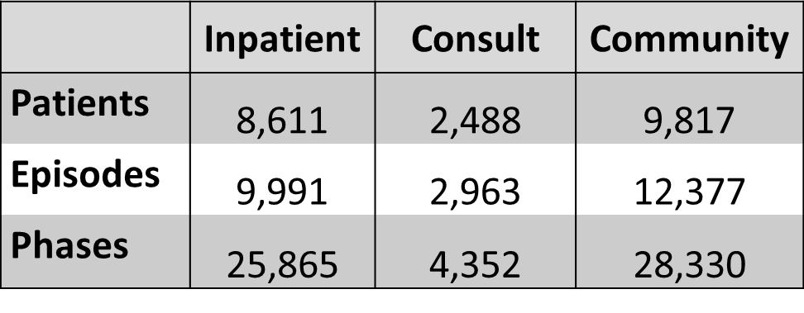
Inpatient, consult and community findings, July – December 2015

Slide 22
Age and gender
% | Inpatient | Consult | Community
< 55 | 12.5 | 11.2 | 5.8
55-64 | 16.2 | 16.0 | 7.8
65-74 | 25.3 | 23.9 | 12.1
75-84 | 24.9 | 28.5 | 13.5
85+ | 21.1 | 20.4 | 9.6
Average age | 72.3 yrs | 71.5 yrs | 71.5 yrs
Median age | 74.0 yrs | 73.0 yrs | 73.0 yrs
Male | 55.5 | 53.5 | 52.9
Female | 44.5 | 46.5 | 47.1

Slide 23
Episode and phase characteristics
Days | Inpatient | Consult | Community
Average episode length | 12.0 | 5.7 | 61.3
Median episode length | 7.0 | 3.0 | 27
Average phase length | 4.5 | 3.9 | 22.8
Median phase length | 2.0 | 2.0 | 7
Average phases per episode (n) | 2.6 | 1.4 | 2.2

Slide 24
First phase of episode by setting

Slide 25
AKPS at beginning of episode

Slide 26
Moderate severe symptoms/problems

Slide 27
Overview
What is PCOC?
What do they collect in PCOC and how does it compare to OACC?
How does PCOC support services?
Examples of findings
What about national quality indicators?
National workshops
Discussion on future directions

Slide 28
What about bench-marking?
Comparisons between services
Need to be fair and meaningful
Local, regional and national
International in future ??

Slide 29
Criteria for selecting benchmarks
Domain is clinically important
Evidence of variation between services and patients
Evidence that the domain is amenable to intervention
The benchmark threshold reflects good rather than average practice (20% percentile)
The benchmark is the same regardless of sector (public/private), location or role

Slide 30
Case-mix adjustment before bench-marking
standardisation to adjust for differences in the mix of patients in each service
allows for more meaningful comparisons of patient outcomes and quality indicators
controls for the impact of phase of illness and initial levels of symptoms and problems on patient outcomes
same approach as standardised mortality ratios which adjust for age & gender

Slide 31
Australian PCOC national quality indicators – timing and phase
90% of patients have their episode commence on the day of, or the day following, date ready for care
90% of patients are in the unstable phase for 3 days or less

Slide 32
PCOC quality indicators – symptoms and concerns
Pain, fatigue, shortness of breath, family concerns
At least 60% of patients with moderate or severe pain/fatigue / breathing problems / family concerns at the beginning of their phase have absent or mild problem at the end of the phase
At least 90% of patients with absent or mild pain/ fatigue /breathing problems /family concerns at the beginning of the phase stay that way

Slide 33
Benchmark 1 – timeliness of care

Slide 34
Benchmark 2 – time spent unstable

Slide 35
Pain: % patients start absent/mild remaining absent/mild (PCPSS)

Slide 36
Pain % patients start moderate/severe end absent/mild (PCPSS)

Slide 37
Pain: % patients starting absent/mild remaining absent/mild (SAS)

Slide 38
Pain: % patients starting moderate/severe and ending absent/mild (SAS)

Slide 39
Research question
Can patient outcomes be improved through the routine measurement of patient-level outcomes at point-of-care?

Slide 40
Method
Analysis of patient outcome data reported by 45 services participating in the PCOC cycle consistently, each year from January 2011 to December 2014
Inpatient (hospice), consultation liaison (hospital and primary care), and community

Slide 41
Results: 2011 - 2014
60,816 patients and 196,152 phases
47% female
79% malignant diagnosis
Average age 72.7 years (SD 14.3)
Statistically significant improvements in
all domains
Not only improvement in outcomes but also ....
Steady reduction in variation in service level outcomes
  greater equity of patient outcomes across Australia

Slide 42
Overview
What is PCOC?
What do they collect in PCOC and how does it compare to OACC?
How does PCOC support services?
Examples of findings
What about national quality indicators?
National workshops
Discussion on future directions

Slide 43
PCOC national workshops:
Services receiving Jul - Dec 2015 report
116 services:
47 inpatient hospice services
12 hospital consult services
28 community services
13 both inpatient hospice and community
16 services did not receive an outcome report (due to data volume or quality)

Slide 44
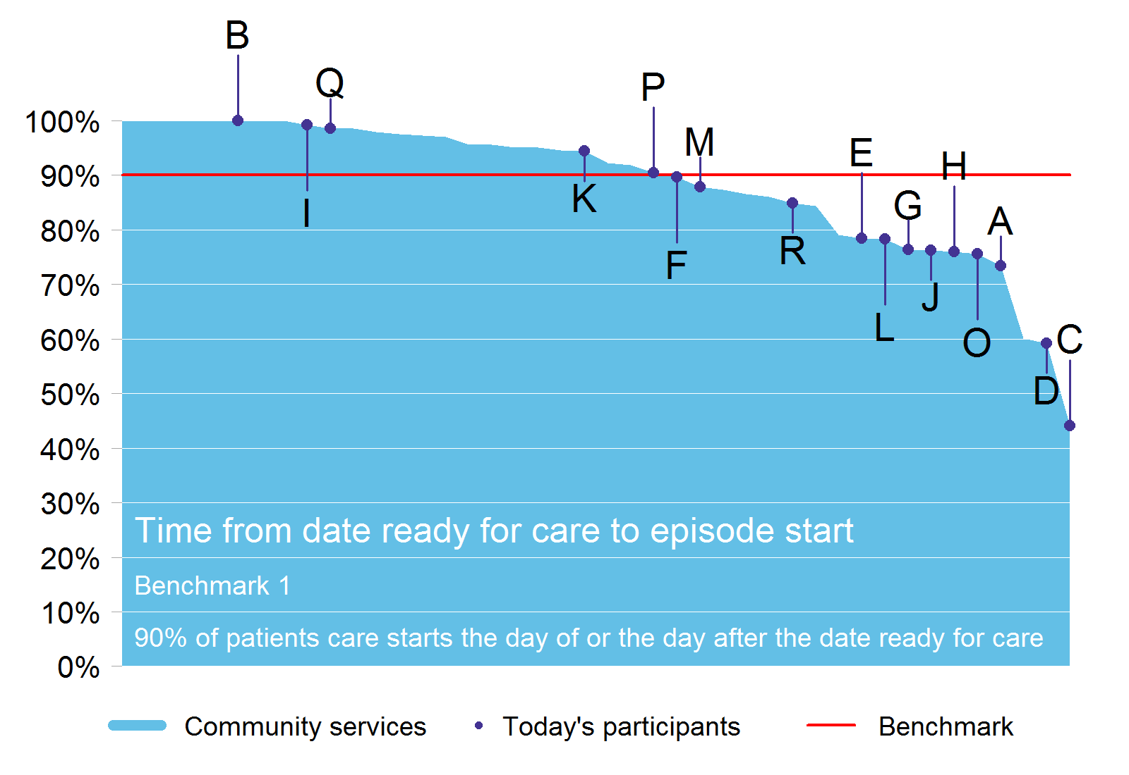

Slide 45
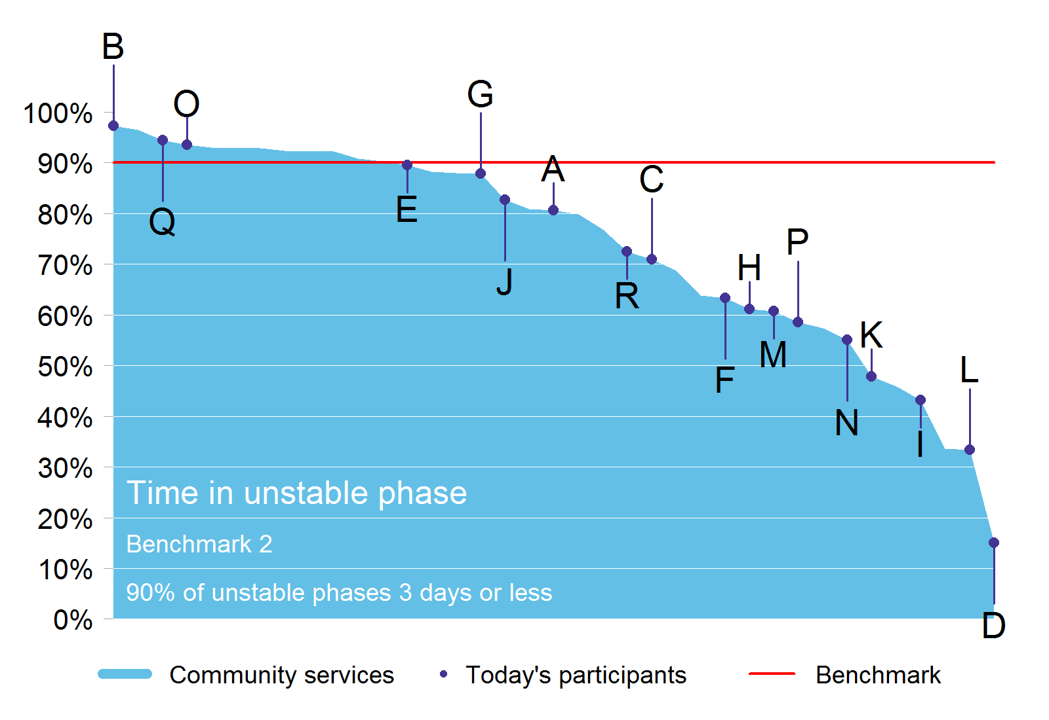

Slide 46
X-CAS symptoms
PCPSS
Pain
Psychological/
Spiritual
Family/carer
Other symptoms
SAS
Pain
Nausea
Bowel problems
Breathing problems

Slide 47
To interpret a casemix-adjusted score
X-CAS for your service > 0
  on average, your patients’ change in pain/symptom score is better than similar patients in the national database
X-CAS for your service = 0
  your patients pain/symptom score changed about the same as similar patients in the database
X-CAS for your service < 0
  your patients’ change in pain/symptom score is worse than similar patients in the database

Slide 48
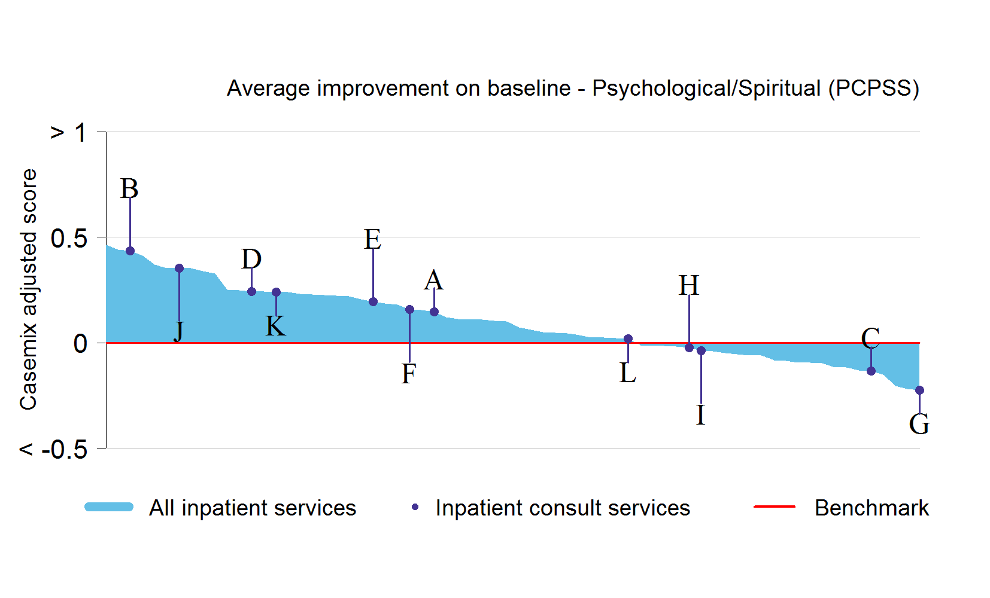
X-CAS: psychological / spiritual

Slide 49
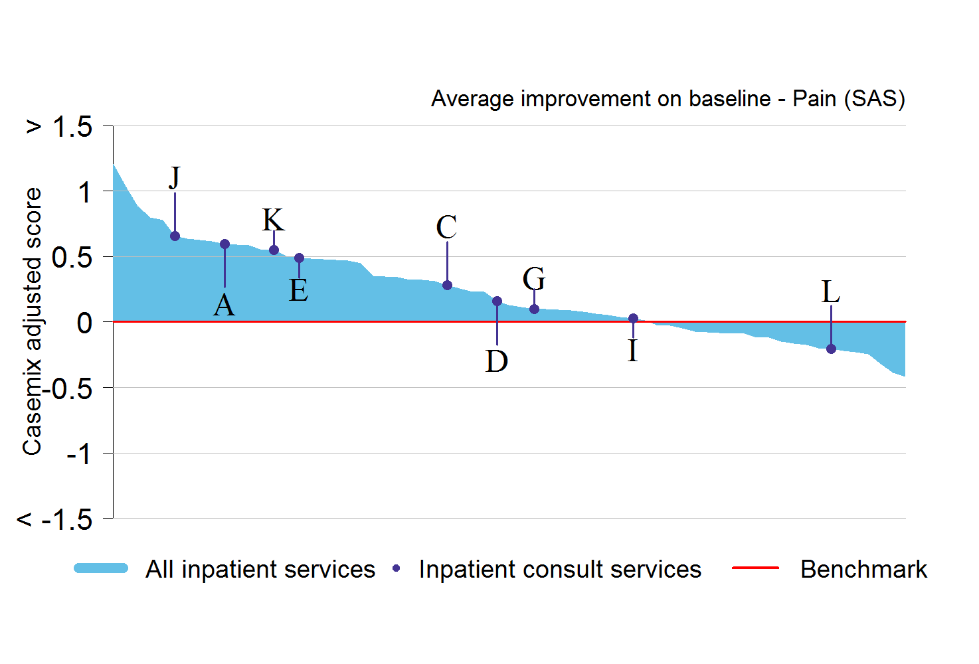
X-CAS: SAS pain

Slide 50
Clinical registries and benchmarking
There is good evidence that clinical registries such as PCOC can improve quality and outcomes
  But only if you close the feedback loop
  Measuring outcomes is not, on its own, enough
There are now many outcome centres (15-20) in Australia, including 3 run by AHSRI
  PCOC
  Australasian Rehabilitation Outcome Centre (AROC)
  Electronic Persistent Pain Outcome Centre (ePPOC)

Slide 51
Clinical registries and benchmarking
PCOC is a voluntary initiative now and there is a lot of government / funder interest in mandating participation
  PCOC has concerns about implications of this
The broader question for governments and funders is whether and how to fund outcome centres
  PCOC is 100% government funded
  AROC is self-funded on a membership model with 100% voluntary participation across Australia and New Zealand (both public and private sectors)

Slide 52
Questions and discussion ...

Slide 53
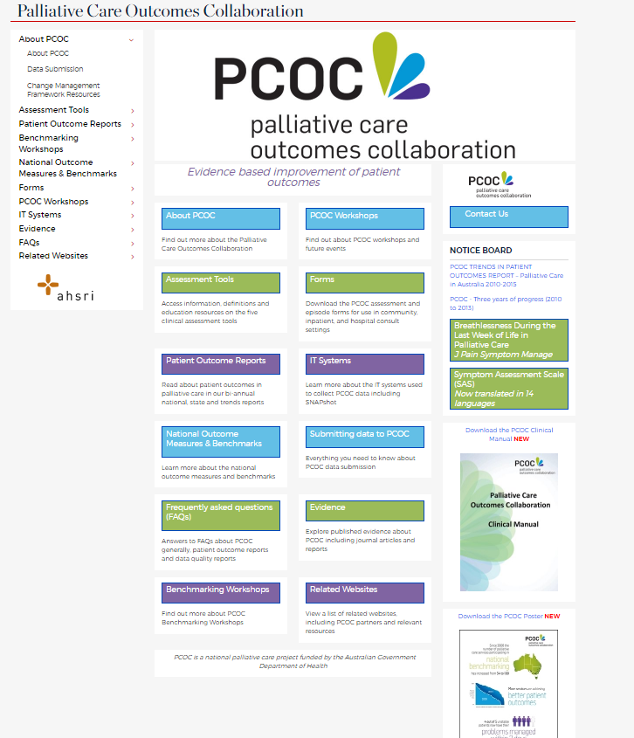
Acknowledgements
Thanks to Professor Kathy Eagar, for her generosity with sharing ideas and materials from PCOC
http://www.pcoc.org.au/

