Slide 1
Nationally, the current climate, future opportunities and challenges
Barry James
Palliative Care Funding Programme Manager
Notes:
Hello my name is Barry James
I am the Palliative Care Funding Programme Manager for NHS England
I am going to try to very quickly give you some of my thoughts on a very big topic
the current climate, future opportunities and challenges for the health sector and palliative care in particular

Slide 2
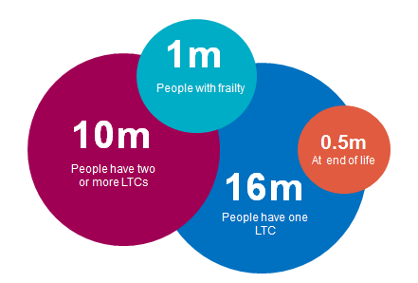
The Current Climate
Notes:
We know People are living longer but not always well
We know The larger the number of co-morbidities a person has, the lower their quality of life generally is
We know evidence indicates that earlier intervention of specialist palliative care increases the quality of life of patients
In England, approximately 470,000 people die each year. This number is expected to rise by 20% by 2035. Three quarters of these are expected deaths
In England and Wales 84% of deaths in 2013 were of people aged 65 or older and 39% were of people aged 85 or older.
At this moment, about 25% of all hospital beds are occupied by someone who is dying - the National Audit Office estimates that at least 40% of these people have no medical need to be there.
Good community based EoLC could reduce hospital costs by £180 million per year
Hospice UK have indicated that the independent sector contributes £1bn annually to the provision of specialist palliative care

Slide 3
By 2020…. “significantly improve patient choice at end of life care… including ensuring an increase in the number of people able to die in the place of their choice, including at home.”
Government’s Mandate to NHS England 2016-17

Slide 4



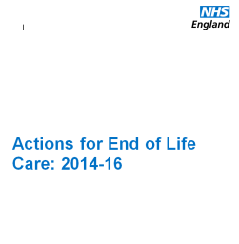
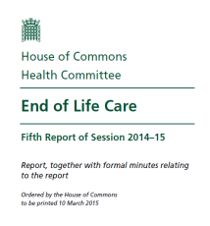

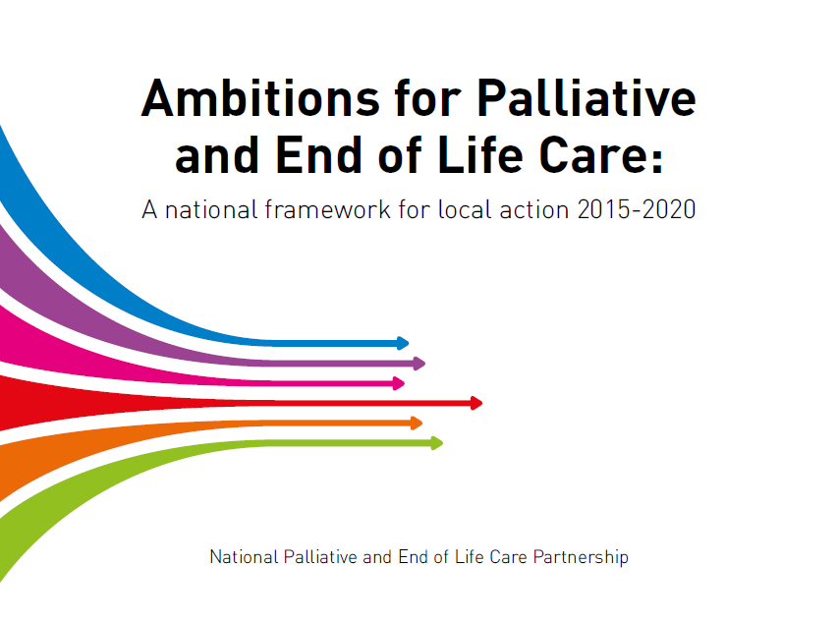
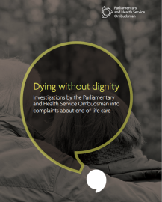
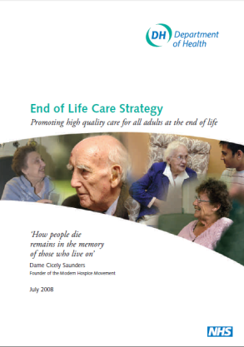

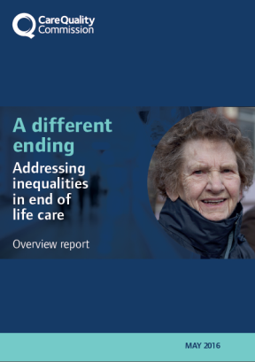
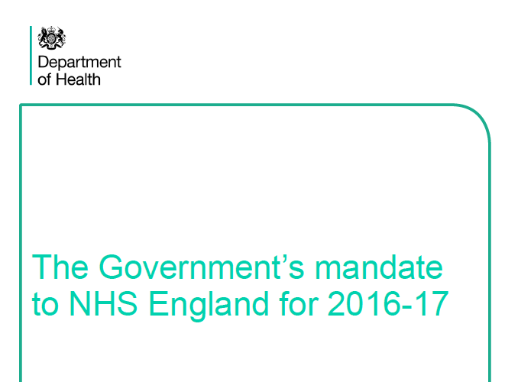
Notes:
There is a huge body of work going on out there to improve services at a local and national level
This slide shows just a few of the reports and recommendations that work is generating.
The sector is changing reducing unwarranted variation through quality standards and service specifications touching more lives through community based engagement and moving increasingly into non-cancer conditions.

Slide 5
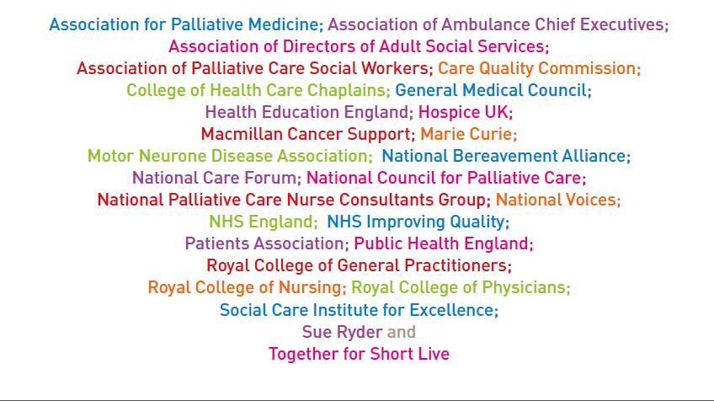
Notes:
Every organisation is playing its part in raising awareness of the issues and suggesting ways forward. From the large national organisations to the small independent hospices that have tested the currency or helped inform our thinking.

Slide 6
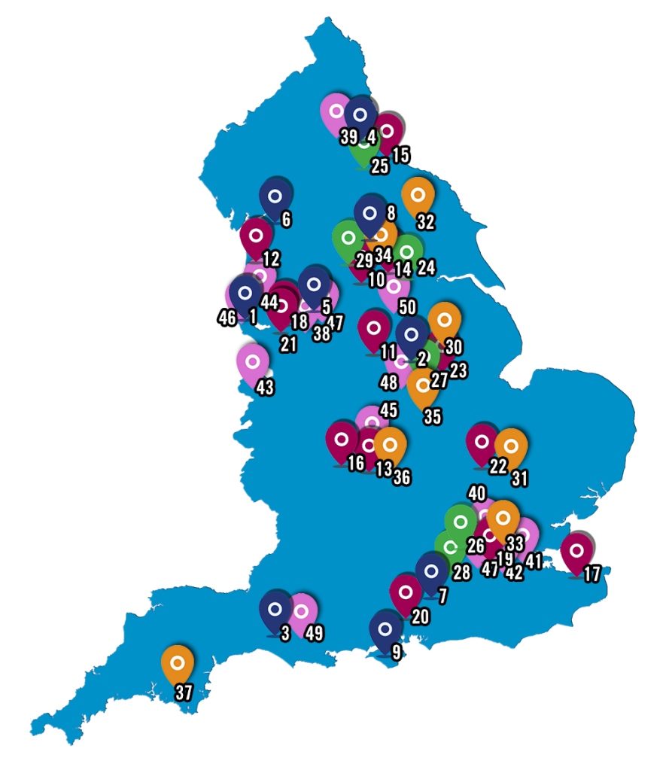


Future opportunities and challenges
Notes:
We have come along way in the last four years, so lets look at what the future holds

Slide 7
Specialist Palliative Care Currencies
New currencies for Specialist Palliative Care providers will be published, alongside guidance on how to use them and case studies (December 2016)
Piloted for several years in acute, community services (adults & children)
Can be used to support the commissioning and payment from April 2017 – potentially mandated from April 2019 (tbc)
Is not a tariff
Think of these currencies as the ‘building blocks’ for payment. Helps commissioners and providers of SPC to understand provision and case complexity of patients being care for.
  Phase of illness
  Diagnosis
  Age
  Setting
  Functional Status
Notes:
We started a journey with a Government White Paper in 2010 and the Palliative Care Funding Review in 2011
In July this year we published Palliative Care Currencies in the Tariff Engagement Document on page 66
We are currently finalising guidance documents to support the use of the currencies and these should be ready for publication in December
(publication is a fairly lengthy process in NHS England as some of you will be well aware)
so the documents are already out for consultation with our Advisory Group and Executive Steering Group.
You may be forgiven for thinking it took an awfully long time to get here, wellIt took the Australian's 13 years to publish their first currencies
we have done it thanks in part to their earlier work in 4 years
but I should stress this is NOT a tariff there are no prices associated with the currency units, and
we are no longer wedded to the notion of a per patient pricing mechanism.
The currencies are building blocks that will support a variety of payment mechanisms
you should view them as a way to demonstrate the complexity of patients being cared for. And the increasing complexity of care you provide
Experience from the pilot sites has shown that it takes approximately 12 to 18 months to fully embed the language of phase of illness into clinical assessment and management processes So for those naïve to the currency you will find its language intrinsic to the work of projects such as OACC and its outcome indicators and the clinical data set – you have a journey ahead of you - there are others in the room better qualified to speak on such things so I will leave that to them.

Slide 8
The Palliative Care Development Currency
Page 11 in ‘Developing a new approach to palliative care funding: A first draft for discussion’
Page 66 in ‘Tariff Engagement Document 2016’
Notes:
These are the currency units split between adults and children and young people
There are 28 units in each group spread across three settings Acute Hospital, Hospice and Community
Acute hospital reflects the costs associated with the advisory role of palliative medicine within acute hospitals and is a top up covering the cost of palliative medicine interventions at the request of admitting specialities.
Community is a catch-all and in this instance it means all non-bed based services where the patient either travels from their normal place of residence or receives care there.
The units are based on the best predictors of cost, those that were engaged in the pilots and last year’s testing will tell you they were not the only items of data we collected we looked at a wide range of possible predictors of cost collecting 139 data items per phase of illness giving us a very rich data source of over 2.4 million items of data.

Slide 9
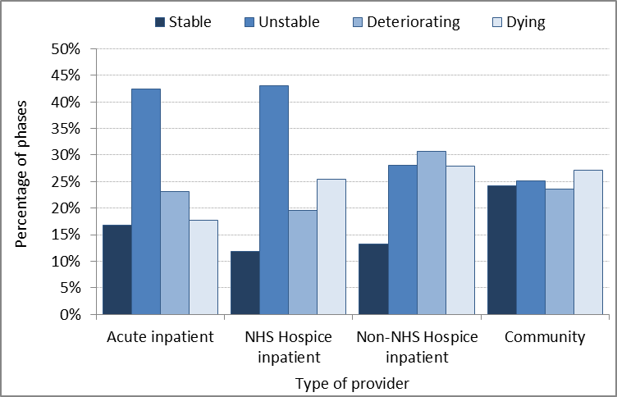
Phase of illness & Provider Category
Adults (test data)
Notes:
I will not dwell on this but here is a quick look at phase of illness – I should stress for the uninitiated that the phase of illness looks at the patient and their environment so includes carers and family circumstances, a patient may be clinically stable but their environment could be such that their conditions is unstable for example.
This slide represents test data from 2015-16 testing, it could just be sample bias or it could be that we have here a demonstration of increasing sophistication of services in the community sector the original pilot showed that the vast majority of community patients were stable you can see in this example that community services see petty much even numbers of patients across all phases. I would like to hope its not sample bias but since I am now picking up Community Services I have my own bias!!

Slide 10
Feedback from sites using the currency
  Sheffield St Luke - transformed MDT meetings condensing 4 separate sessions into one single meeting that is completed in half the time, as a result of embedding into their clinical assessment/management processes the language of phase of illness and the use of IPOS outcome measures.
  Using the currency framework of phase of illness has allowed many hospices to improve their forward planning and to understand better their patient needs.
  All report that working with the currencies has given clarity to the impact they have on patients and families and provided evidence of the complexity of their caseload.
  North London Hospice continue to use the currency pilot data collection template because it has proved useful in dialogue with local commissioners.
  Small independent hospices such as Blythe House near Glossop have found they are in a better position to explain what they do and the impact they have on the local health economy.
Notes:
Feedback that we had from pilot and test sites was quite interesting and illustrates some of the benefits.
St Luke’s here have transformed their MDT process making it far more effective and time efficient which was I think and Judith can correct me if I am wrong was not entirely foreseen when they started this process.
North London and their commissioners in Edmonton have found the data so useful they have kept it up post pilot.
And hospices large and small across the country have found they are in a better position to explain and demonstrate to commissioners the impact they have and the benefit to the local health economy
The pilot was always about being cost neutral being able to demonstrate savings through interventions should improve commissioning prospects

Slide 11
Palliative Care Clinical Dataset
Commissioned by NHSE and developed by PHE. Also aligns with the Outcome Assessment and Complexity Collaborative (OACC) initiative, led by the Cicely Saunders Institute (CSI) at King’s College London and in partnership with Hospice UK.
Data set, and guidance for its use, will be made available for use by clinicians, service providers and commissioners in the Autumn 2016.
Voluntary. Data items are aligned with the SPC currencies but there are more items on outcomes e.g. breathlessness / at peace
Can be adopted by commissioners/ providers to understand the current clinical provision of specialist palliative care and evaluate outcomes.
Nationally, looking to include some of these data items within new/expanding data collections
Notes:
Sarah is going to speak about the Palliative Care Clinical Data Set that was funded by NHS England but led by Public Health England and Sarah of Course was the Chair of the Clinical Expert Group.
What I would like to say is that although the project has not been funded this year I am currently charged with developing the data content of phase II of the soon to be nationally mandated Community Services Data Set and we are looking to include much of the work that was done to develop the PCCDS.
We will change it slightly in that the current trend is to try to take values and put them into SNOMED it allows for easier updates so that is one avenue I will personally be exploring over the coming 12 months.
Phase I of the Community Services Data Set is currently anticipated to be flowing data by the end of 2017.

Slide 12
What else is going on?
247 SPC model evaluation
Clinical Advice Hubs as part of UEC
Knowledge hub
Testing Personal Health Budgets – expect this to ramp up in 17/18
Improved communication – webinars – facilitators, wider reach – sharing learning from NCM, roadshows series with DH
Community nursing 24/7 teams – socially motivated investment
Annual HQIP audit – care of the dying adult in hospital. CQC inspection and oversight board. NHSI support.
Patient empowerment and control: film, campaign, personalised care & support planning EPaCCS, access to own records to edit
Notes:
24/7 SPC Model evaluation
Clinical advice hubs as part of Urgent and Emergency Care
Community Nursing 24/7 teams to name a few

Slide 13
Future opportunities and challenges
Notes:
The over-riding feature of the Five Forward View is how do we pay for the Health Services we need going forward with a projected £30bn per year budget shortfall by 2020/21 - significant efficiency savings have to be made from cost avoidance and cost reduction but even if all those efficiencies are met there will still be a need for at least £8bn per year more from the government.
NHS England is investing in new ways of delivering care looking to remove system blockages and incentivise integrated ways of working – the map shows the many vanguards currently engaged in new models of care:
MCPs Multi-speciality Care Providers
Rightcare – Integrated care teams
PACS Primary and Acute Care Systems
And now
ACC Acute Care Collaborations
On top of STP Sustainability and Transparency Plans that are set to change the commissioning landscape yet again
You may think that whole population budgets are a return to the old block contact but these budgets will be supported by clear values based on currencies and contracts with embedded outcomes for both efficiency and effectiveness there are no future soft options.
NHS England is being increasingly less prescriptive about the process of care delivery but much more focused on the effectiveness of the care that is delivered.
The right care at the right time for the best possible outcome for the patient.
Improving the quality of people’s lives and the health of the population as a whole
My question and challenge to all of you – and I have to say I don’t have an answer – I don’t believe there is a single answer – but my question is - actually - my questions are:
How can we bring specialist palliative care and end of life care back into mainstream care delivery?
How can your organisations touch more lives?
How can you engage in and support a sustainable future for yourselves as independent organisations and be an active participant in this ethos of integration and new models of care?

Slide 14

Thank you for listening
england.pcf@nhs.net
barry.james@nhs.net
any questions?

